Slide 1
RightsHero
Anti Piracy Solution

Slide 2
TABLE OF CONTENTS
1
2
Rightshero -Anti Piracy
Product Vision
3
4
Product Strategy
Product Challenges/Problems
5
6
Product Competitors
SWOT Analysis
7
8
Product Features and Priorities
Product Roadmap

Slide 3
RightsHero - Anti Piracy
RightsHero Offers: Secure and protect online content on all major search engines, video platforms, file hosters, and illegal streaming services for increase your copyright’s lifetime value.
How RightHeros work?
Track : Detect pirated content anywhere online in real-time, and we ensure all pirated content entry points are thoroughly analyzed and monitored.
Analyze: where your content is pirated from including geographies and demographics. This enables you to gain insight into consumer behavior and consequently target your marketing efforts to unlock potential markets.
Delete :removing pages pirating your content from search engine results, an audience in targeted markets will only find your official pages when they search for your content on Google or other search engines.
Report: In your dashboard can see the links you have reported and closed, and can download different data reports according to your needs.

Slide 4





Product Vision
VISION
What is your purpose for creating the product?
Which positive change should it bring about?
Our vision is to protect content on all major search engines, video platforms, file hosts, and illegal streaming services by thoroughly analysing and monitoring all entry points to pirated content.
TARGET GROUP
NEEDS
PRODUCT
BUSINESS GOALS
Which market or market segment does the product address?
Who are the target customers and users?
What problem does the product solve?
Which benefit does it provide?
What product is it?
What makes it stand out?
Is it feasible to develop the product?
What are the business goals?
Protect on all platforms
Market to the right consumer
Monetize your content
Delisting from search engine
Apps Stores Protection.
Protect non-Latin language
Maximise the value of digital assets and increasing your copyright’s lifetime value from online piracy, as well as to ensure the full lifetime value of their creations
Film & TV
Publication & Media
Gaming
Music
Others
Software
Services
Automatically de-listing pirated pages from Google or other search engines.
Real-time monitoring and detection of any pirates.
Providing multiple platforms.
Live Streaming Disruption.
Monetize content.
Apps Stores Protection.
Protect non-Latin language

Slide 5
Product Strategy
Mission:
Securing and protecting illegal content at the source and increasing your copyright’s lifetime value.
Vision:
Protect content on all major search engines, video platforms, file hosts, and illegal streaming services by thoroughly analysing and monitoring all entry points to pirated content.
Competitive Advantage:
Protect on all platforms- Market to the right consumer- Monetize your content - Delisting from search engine - Apps Stores Protection - Protect non-Latin language
Strategic Objectives:
Market segmentation, Product market fit, and delivering the value customers expect from anti-paircy solutions
Short-term goals:
Increasing company revenue by 30% - Expanding into five new countries - Live Customer support - Brand Protection Software -helping businesses around the world seamlessly recover legitimate revenue -data enrichment improves your customers’ experience.
Initiatives
Optimize Operation - worldwide reach -Performance improvements - Better reporting

Slide 6
Challenges/Problems
Optimize Operation.
Worldwide Reach.
Block access to malicious resources
Alert users of piracy attempt
Take down pirated online resources
Remove pirated copies
Live Agent Support
Detailed pricing model based on kind of solution the customer needs
Improve the current website content and provide more information about what the product offers & success stories.

Slide 7

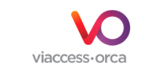





Competitors
Notes:
https://www.redpoints.com/solution-piracy/
https://www.viaccess-orca.com/tv-piracy
https://anti-piracy.nagra.com/
https://irdeto.com/anti-piracy/
https://www.vdocipher.com/blog/2022/06/video-piracy-solutions/
https://www.muso.com/products/protect
https://corsearch.com/

Slide 8
SWOT Analysis
S
W
O
T
Strengths
Weakness
Opportunities
Threats
Automatically de-listing pirated pages from Google or other search engines.
Real-time monitoring and detection of any pirates.
Providing multiple platforms.
Live Streaming Disruption.
Monetize content.
Apps Stores Protection.
Protect non-Latin language
Live Customer Support
Enrich Current website content
Performance dashboards
customs reports
Brand Protection
trademark monitoring software
Take down fake websites.
Pricing model
Anti-piracy competitors
Live Customer Support

Slide 9
Product Features & Priorities
Remember
Enrich Current website content
Enriched website data to be more visually appealing
Product videos, “how-to-use” videos
Optimizing content for localized personas.
Include well-designed and well-written headlines.
Live Customer Support
Live Chat
Automatically route conversations with custom bots.
Instantly answer your customers’ common questions with Resolution Bot.
Track Customer data
Faster customer resolution
Brand Protection
Image recognition scans photos to detect counterfeits.
Machine learning makes the detection of fakes self-improving and suggests.
Automatically remove counterfeits.
Analyze the results of your brand protection actions .
Displaying data in customized dashboards and reports.
Product Goals :
Increasing company revenue by 30% -
Expanding into new countries
helping businesses around the world seamlessly recover legitimate revenue
data enrichment improves your customers’ experience.

Slide 10
Product Priorities
I Impact
C
Confidence
E Ease
Using I.C.E Technique
 | I | C | E | Score | Details | Priority | #
Enrich Current website content | 7 | 8 | 10 | 25/30 | Enriched website data to be more visually Including well-designed and well-written headlines. |  | 1
Live Customer Support | 8 | 8 | 8 | 24/30 | Live Chat Automatically route conversations with custom bots. Instantly answer your customers’ common questions with Resolution Bot. |  | 2
Brand Protection | 8 | 8 | 5 | 21/30 | Image recognition scans photos to detect counterfeits. Automatically remove counterfeits. Analyze the results of your brand protection actions . Displaying data in customized dashboards and reports. |  | 3
High Priority
High Priority
Medium Priority

Slide 11
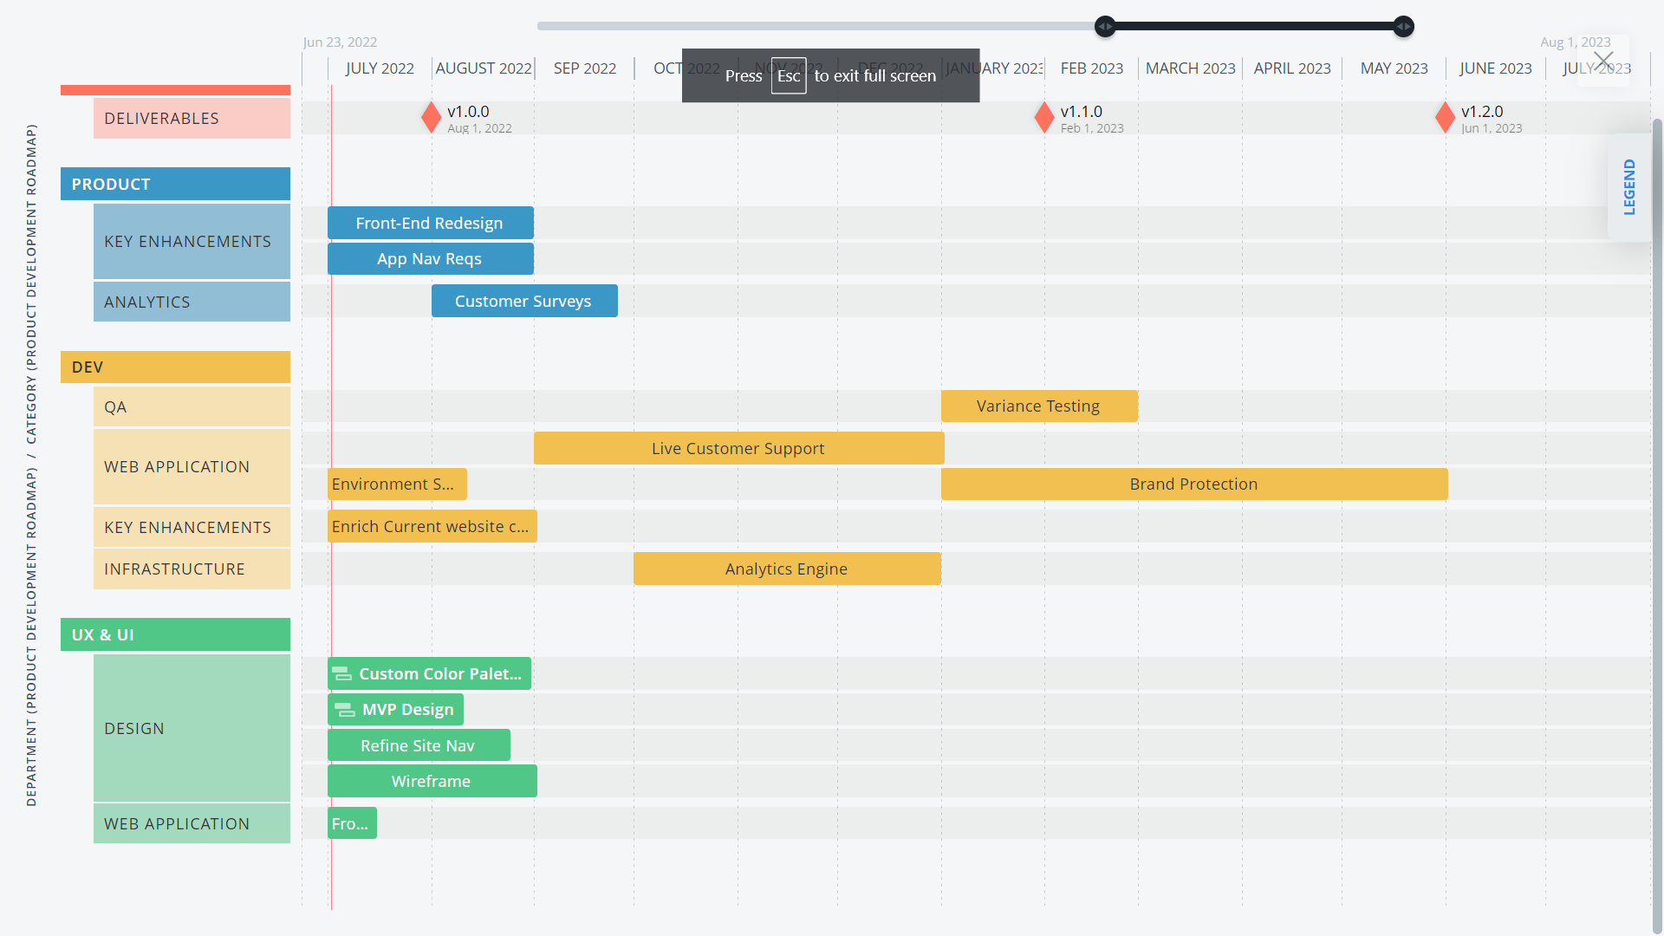
Product Roadmap

Slide 12
References
https://medium.com/swlh/the-challenges-of-product-discovery-6ac6109d13a8
https://www.meret.design/double-diamond
https://www.hallaminternet.com/how-to-think-creatively-using-the-double-diamond-framework/
https://www.redpoints.com/solution-piracy/
https://www.redpoints.com/solution-piracy/
https://www.viaccess-orca.com/tv-piracy
https://anti-piracy.nagra.com/
https://irdeto.com/anti-piracy/
https://www.vdocipher.com/blog/2022/06/video-piracy-solutions/
https://www.muso.com/products/protect
https://corsearch.com/
https://open.spotify.com/episode/63bbbL7YleMtN5fduavp0W?go=1&sp_cid=3e44eb6be964432809b1256ce0782feb&t=72&utm_source=embed_player_v&utm_medium=desktop&nd=1
https://www.productschool.org/

